Slide 1
tinyurl.com/ hackhyland2023
Everything you need to know for the Hackathon, all in one place!

Slide 2
Sunday Schedule
8:30-10:30AM | Grab-n-Go Breakfast | Hallway
1:00PM | + Entry Round: Videos Due + | Workstations
1:00-2:00PM | Lunch | Hallway
2:00PM-3:00PM | Workshop: Presenting 🖌️ | Auditorium
3:45PM | + Top Teams Announced + | Auditorium
Full schedule available at tinyurl.com/hackhyland2023

Slide 3

Strive for Greatness
tinyurl.com/hackhyland2023

Slide 4
Earn Tickets
⚒ Attend Workshops ❔ Ask Good Questions 🎴 Help Others 😇 Be Nice 💪 Work Hard
WIN PRIZES
tinyurl.com/hackhyland2023

Slide 5

Shoot for the Stars
tinyurl.com/
hackhyland2023

Slide 6
Hold up!
Have to leave the building? Make sure you sign out with a mentor before you depart.
More information at tinyurl.com/hackhyland2023

Slide 7


Contact
Discord
Phone
Email
Reach mentors and facilitators online
Caitlin: (216) 469-4921
Marissa: (216) 314-7660
Joseph: (216) 218-2609
Visit the Mentor Room
Send a message to techoutreach@hyland.com
More information at tinyurl.com/hackhyland2023

Slide 8
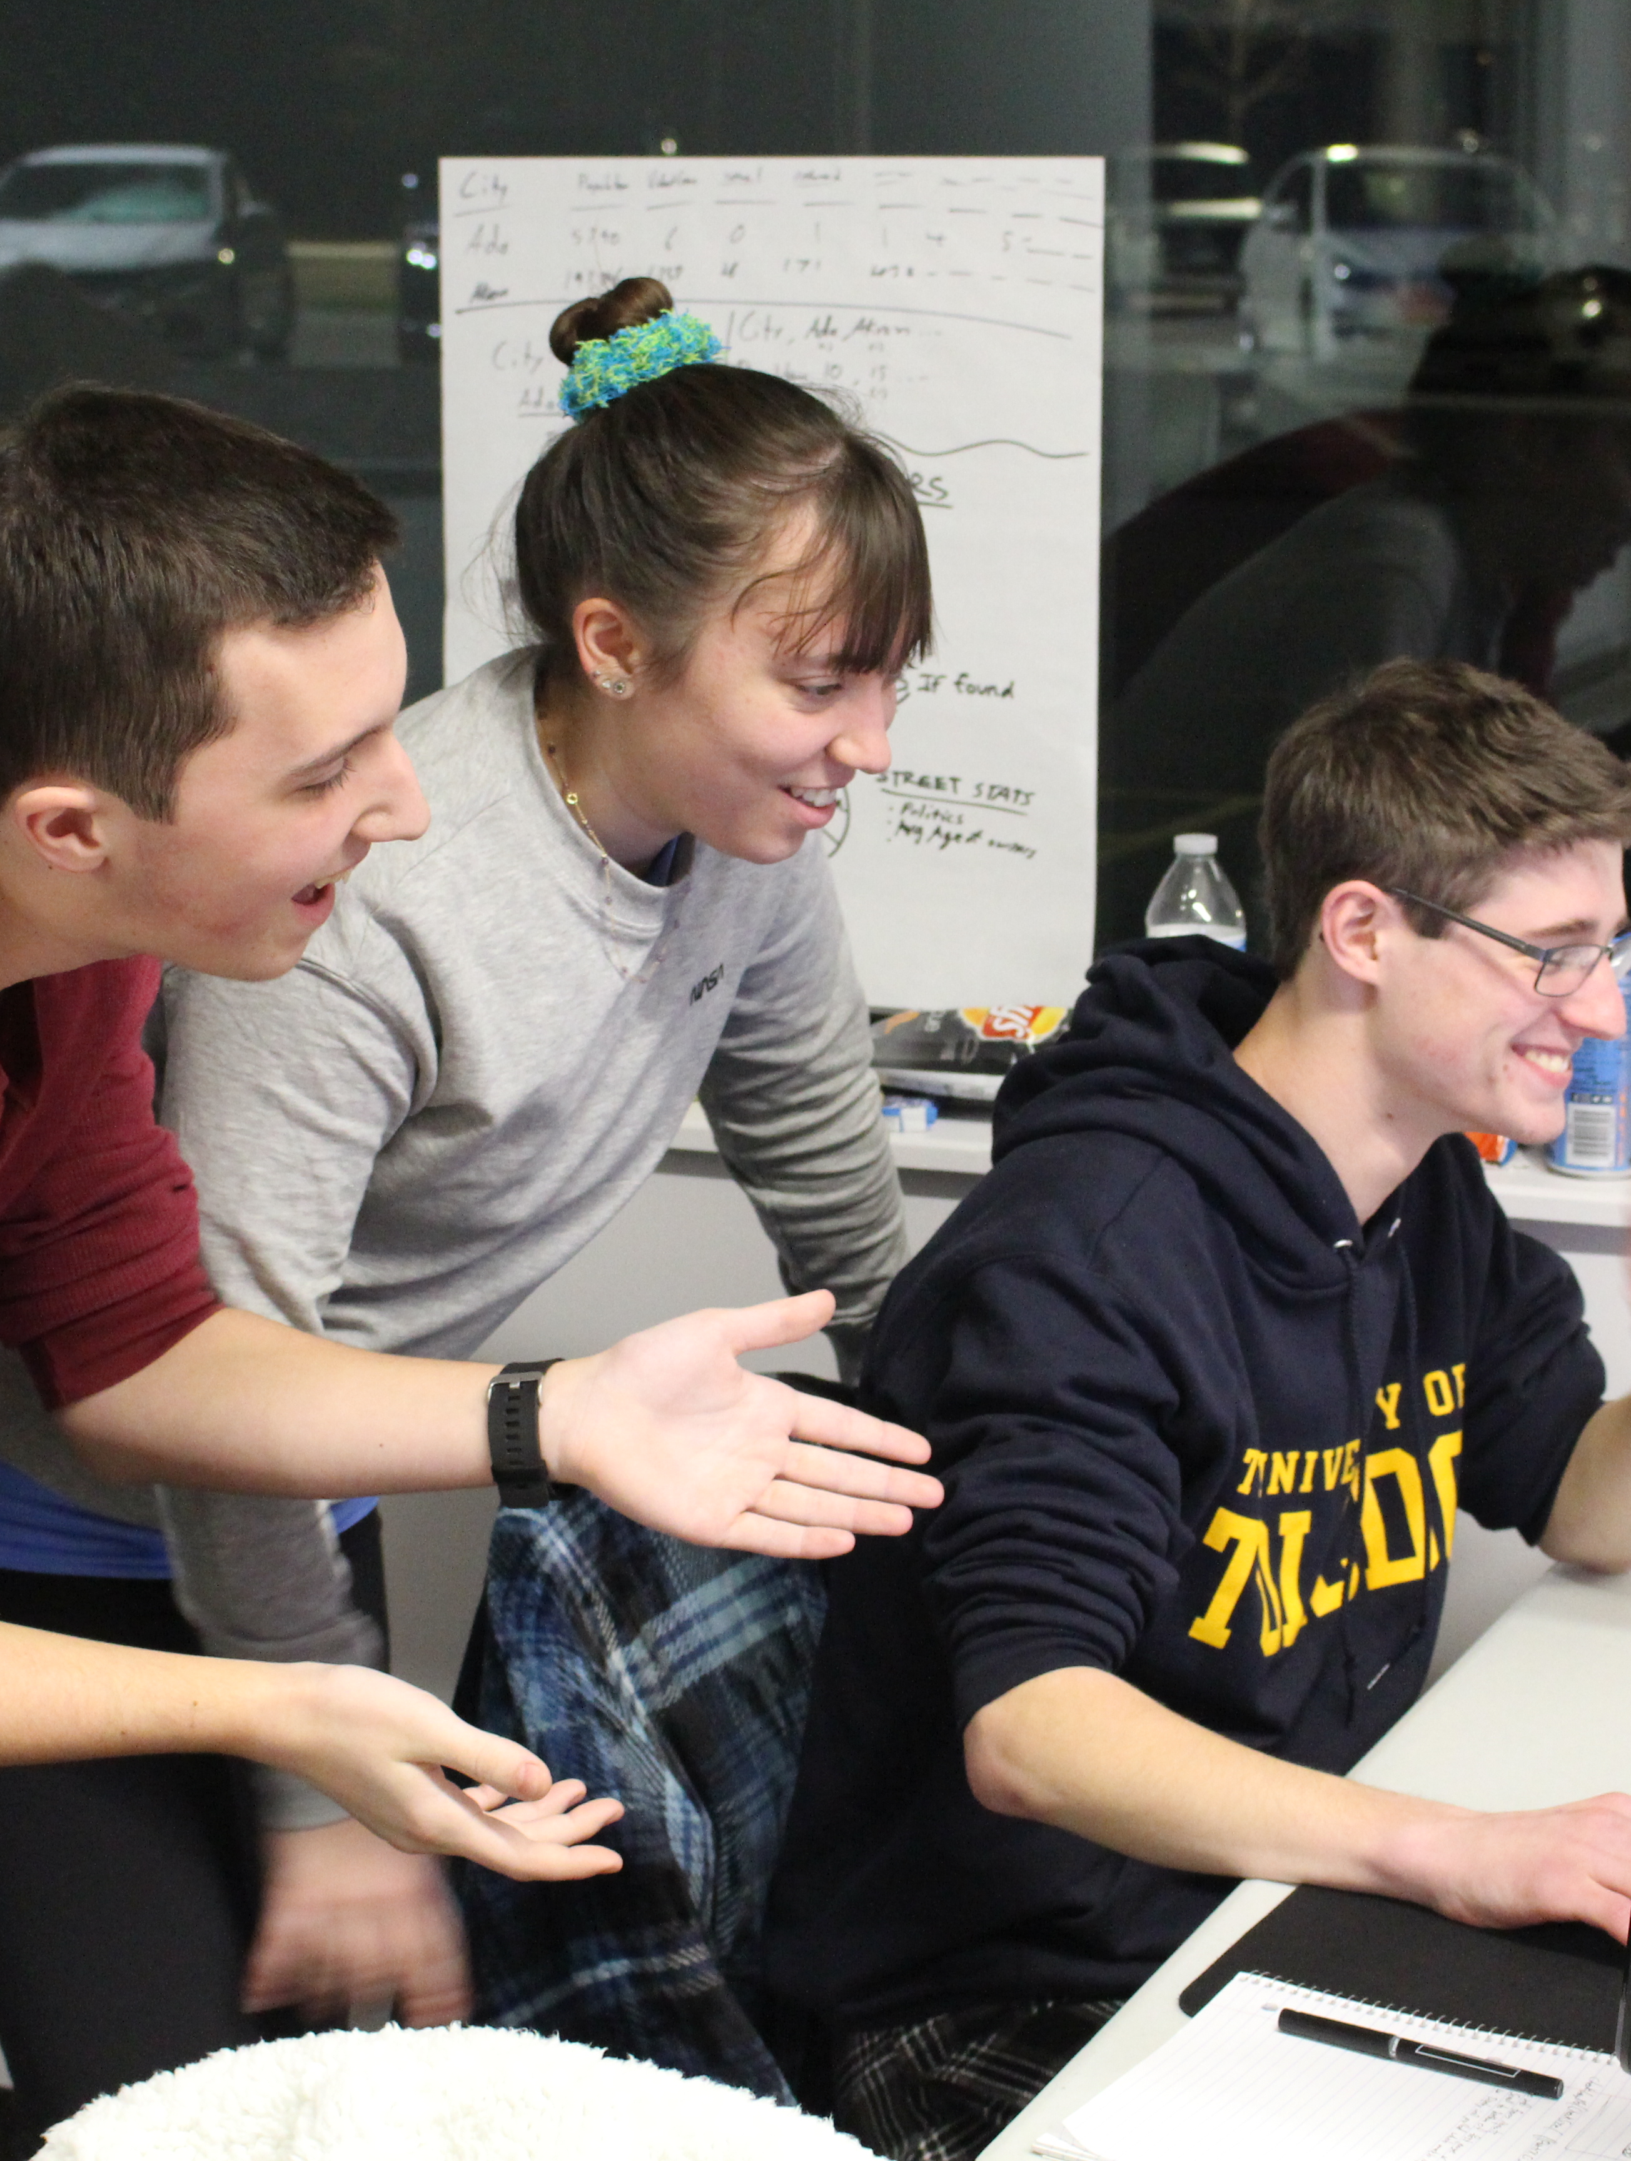
Photos & Posts
Share your Hackathon experience with the world
Use #HylandHackathon on your posts for a chance to be featured on Hyland social media 😎
tinyurl.com/hackhyland2023

Slide 9

Believe in Yourself
tinyurl.com/hackhyland2023

